Slide 1
Norm Evangelista
Software Engineering Candidate,
Flight Software Team

Slide 2
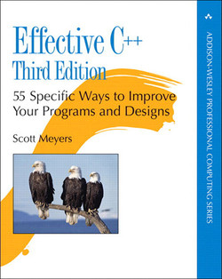
Why Vast Should Hire Me
Effective C++ by Scott Meyers inspired me to start writing C++ in 1992.
I’m a disciple of best practices in software development.
I’m a well-rounded software engineer; I’ve been involved in all aspects of the software development lifecycle.

Slide 3

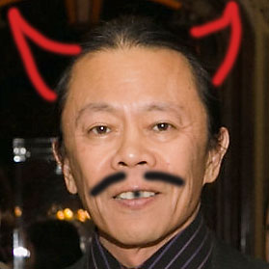
Why Vast Should Hire Me
I bring positive energy to any team.
I’m handsome, intelligent,
modest and unassuming.

Slide 4
MTC Focal Plane Array Calibration
MTC (Missile Track Custody): U.S. Space Force missile tracking system in MEO (Medium Earth Orbit)
Fundamentally an infrared telescope with an 8k x 8k array of pixels in a Focal Plane Array (FPA)
Calibrating the FPA (Radiometric Calibration) is an important step in assuring image fidelity for accurate image processing

Slide 5
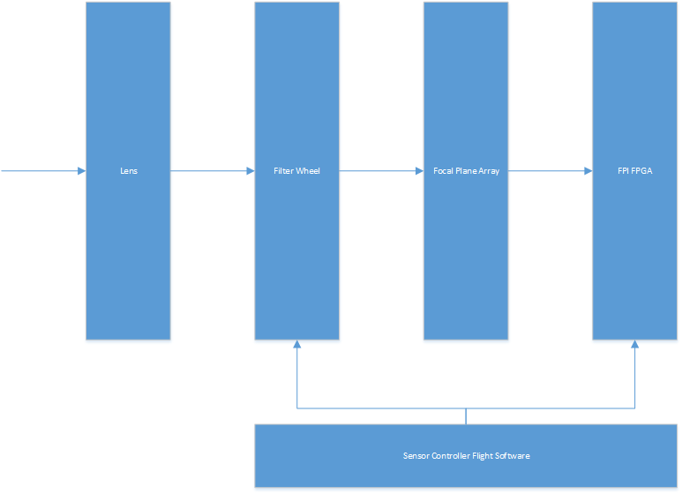
Infrared flow
Stare mode IR camera
Multi-position filter wheel
8k by 8k Focal Plane Array
2 Focal Plane Interface (FPI) FPGAs, handling 4k each

Slide 6
FPA Calibration Issues
The Architecture Design Document (ADD) that described the radiometric calibration process was somewhat impenetrable
  I parsed it and presented the process as I understood it at the weekly joint meeting of the Systems Engineering, Firmware, and Flight Software teams
  I processed the “Yes, but” clarifications, and worked with various tech leads to revise the calibration flow
The function of the Focal Plane Interface (FPI) FPGA was scattered between an Interface Definition Document (IDD), the FPI Data Description Document (DDD), and tribal knowledge
  I clarified the correct FPI registers and fields that were used with the Firmware team

Slide 7
FPA Calibration Issues (2)
The declaration of the Ground Modifiable Memory (GMM) that the Ground team used to define calibration parameters was absent from the FSW code
  I reverse-engineered the process for adding GMM definitions to the FSW, and created a new set for radiometric calibration
Which FPI registers to use to store the variance/standard deviation results calculated by the FSW were not clear
  Clarified with Firmware team

Slide 8
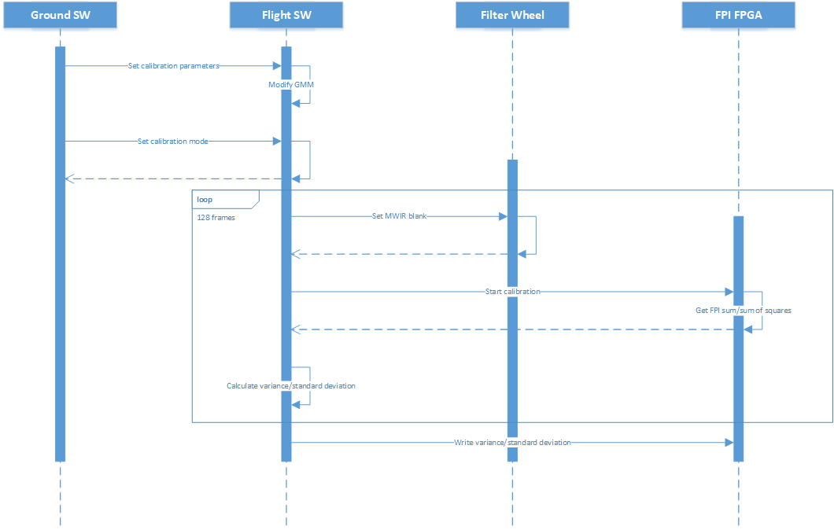
Calibration sequence
128 frames
FPI FPGA accumulates sums/sums of squares
FSW calculates variance/standard deviation, stores into FPI FPGA
Repeats for second IR band

Slide 9
Vast & The CubeSat Market
CubeSats are small form factor satellites
The standard unit is a 10cm cube (called 1U)
CubeSats come in multiples of U (2U, 3U)
Varied missions, launched as secondary payloads
Deployed on-orbit using a spring-loaded deployer (Poly-Picosatellite Orbital Deployer (P-POD))

Slide 10
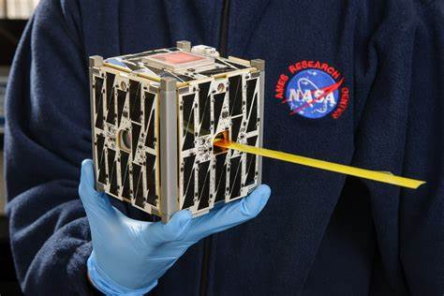
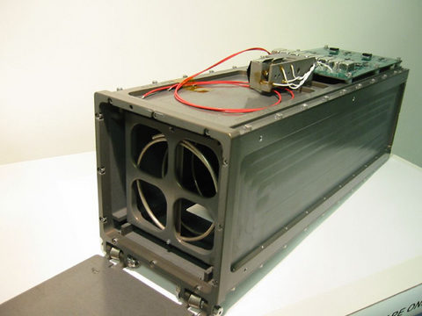
CubeSat & Launcher
1U CubeSat
P-POD CubeSat Launcher

